Slide 1



















Prediction of Health Status Based on BMI
Remember to check your BMI...
25%

Slide 2

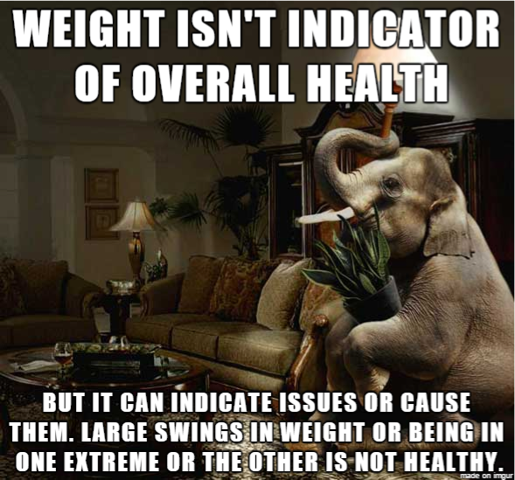
Prediction of health status based on BMI
BMI prediction is constantly mocked by the media and the general public. “Is B.M.I. a
Scam?” is a question that most people and the media ask.
I would like to prove my hypothesis and demonstrate how beneficial BMI checking and
keeping track of your weight in line with your height is for a human being to live a healthy life. Using Kaggle datasets and machine learning models of random forest/linear regression to train existing datasets and do predictions for the new dataset.
2

Slide 3

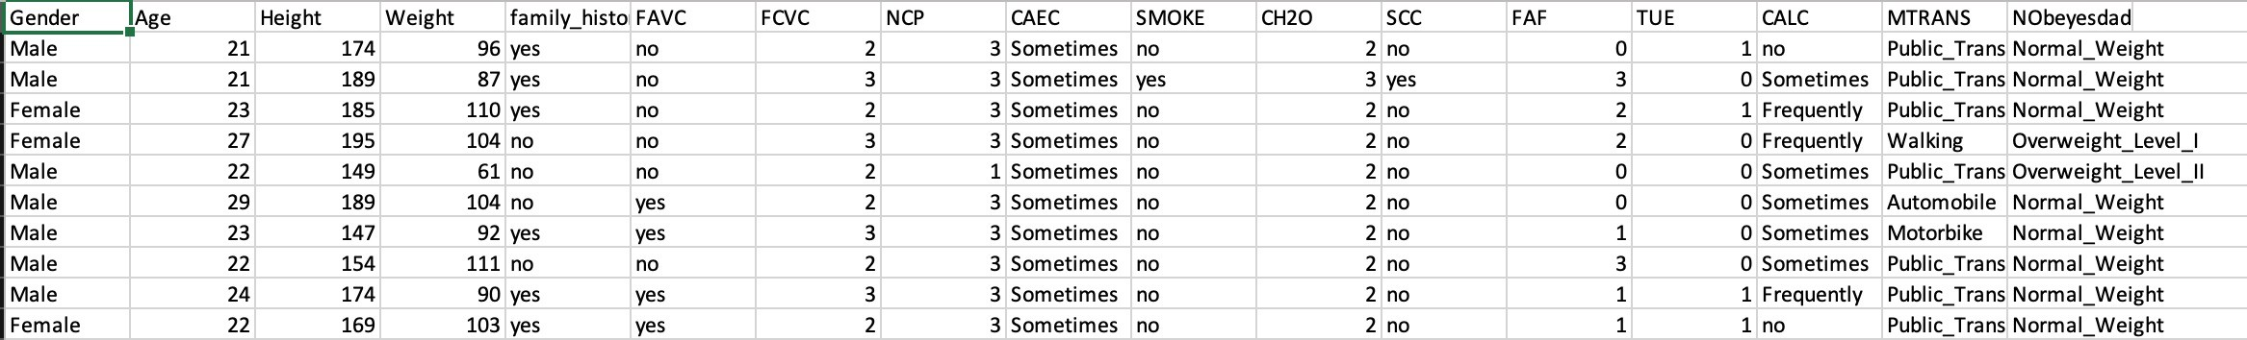
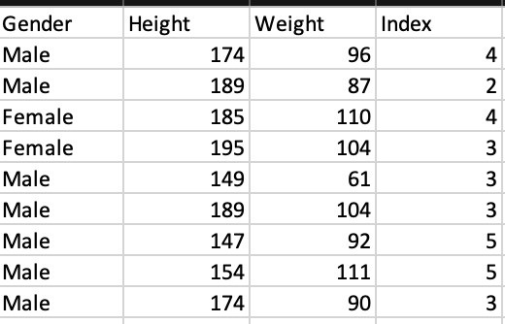
DATA COLLECTION:
Raw data

Slide 4

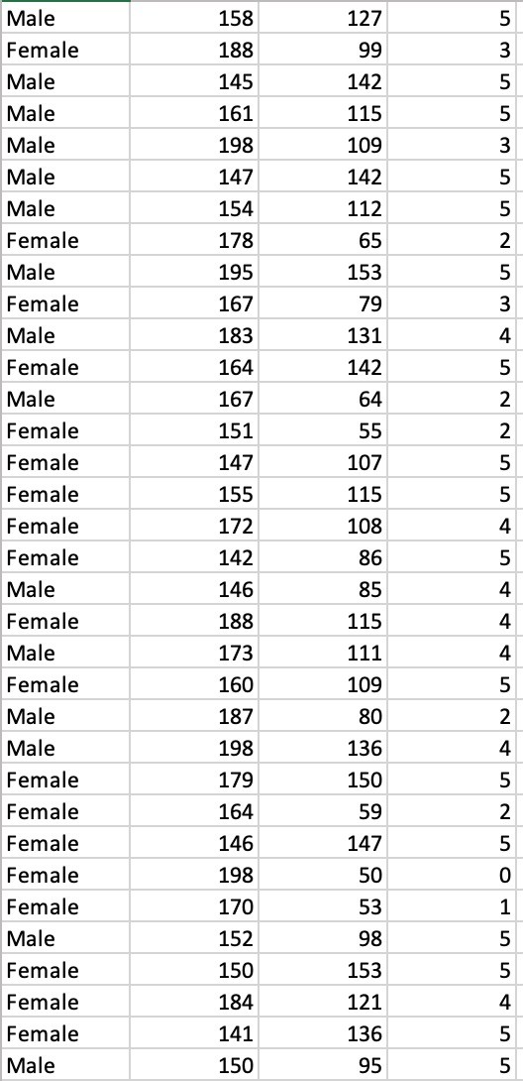
DATA COLLECTION:
Dataset cleaned
Final Cleaned FOUR Columns: "Gender", "Height", "Weight", "Index"
Total = 500 rows; 4 columns

Slide 5
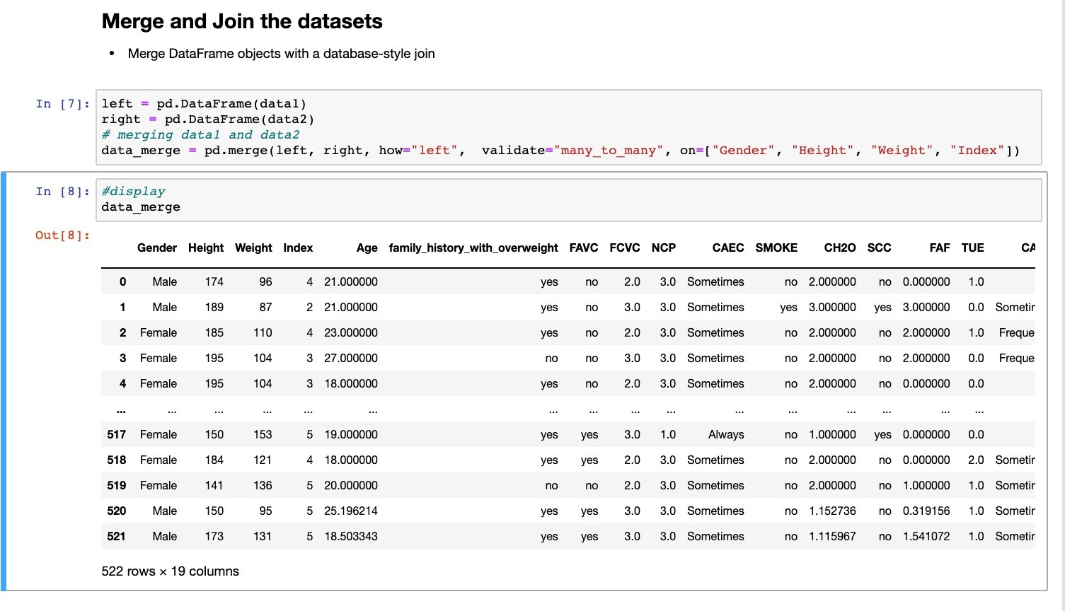
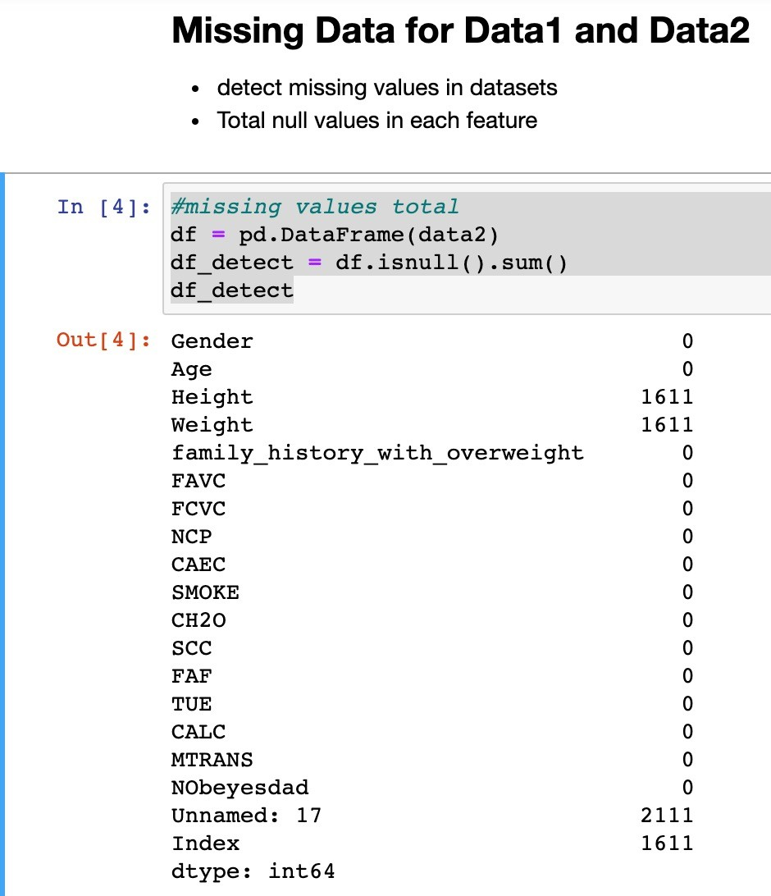
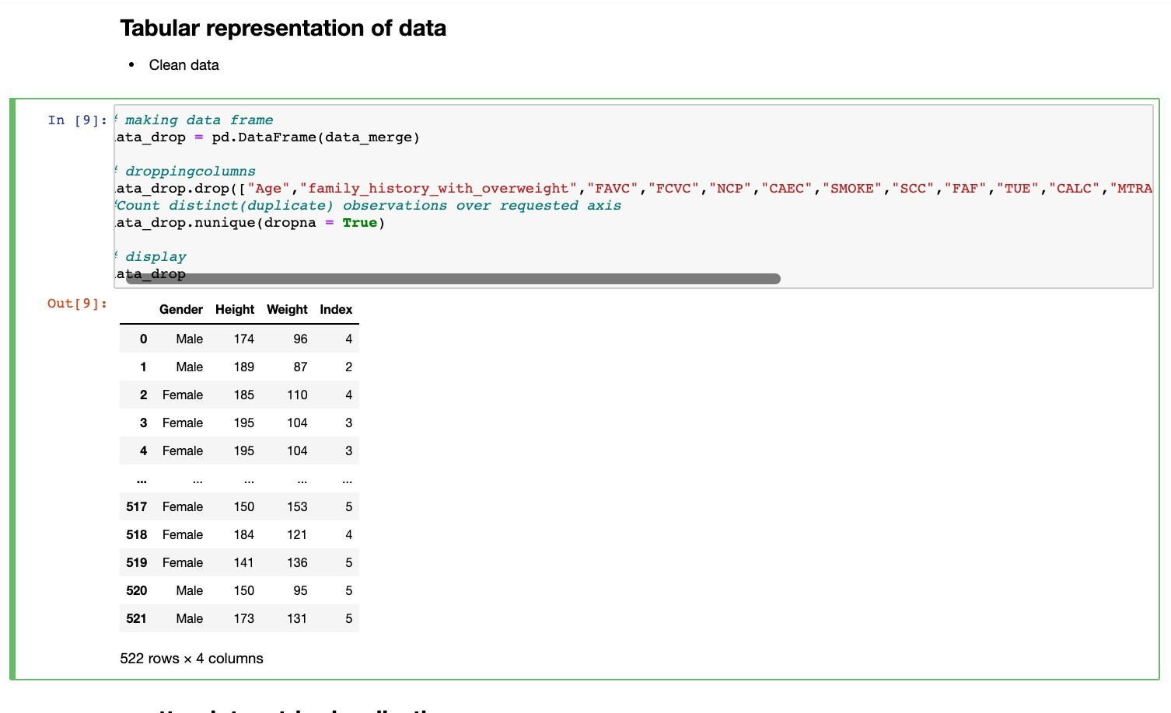
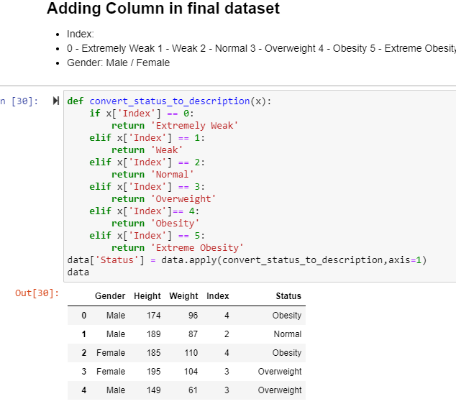
DATA FORMATTING:

Slide 6
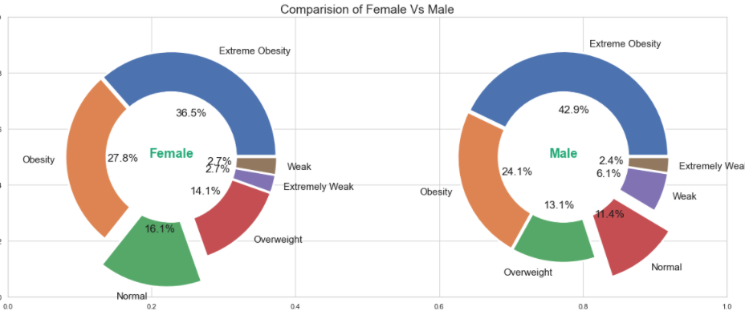

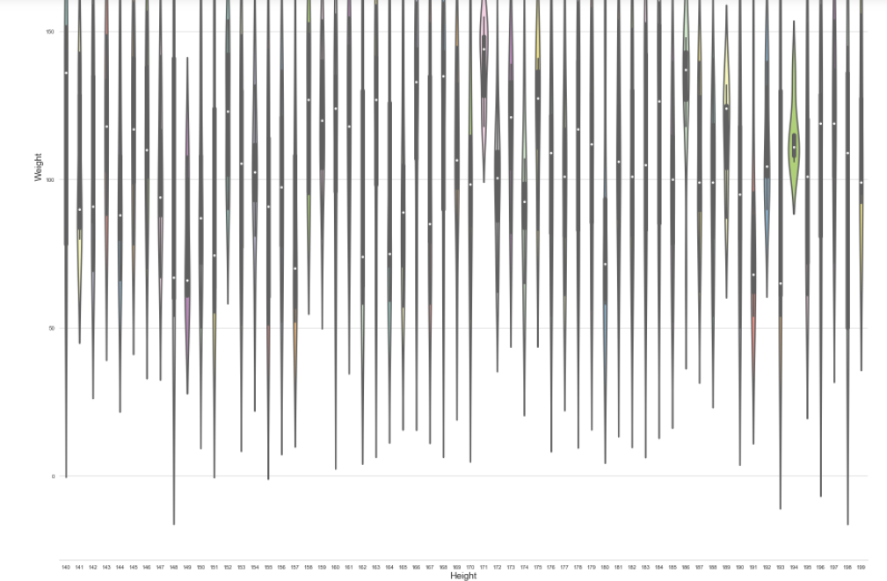
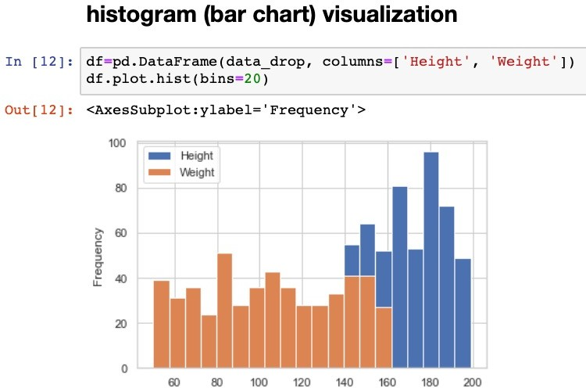

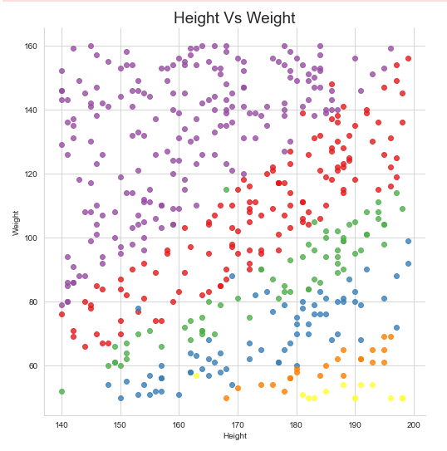
DATA FORMATTING:

Slide 7
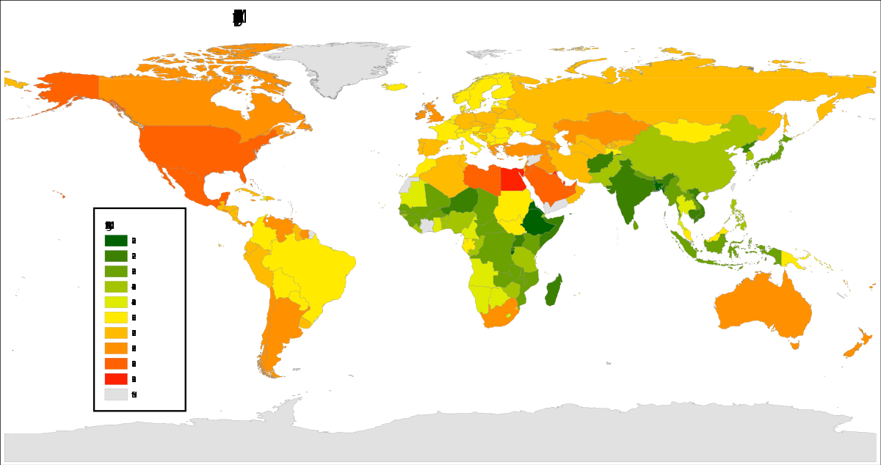
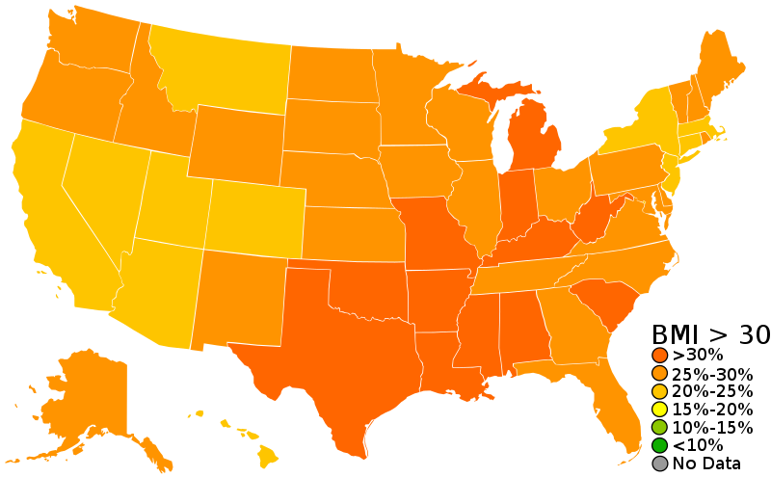
This Photo by Unknown Author is licensed under CC BY-SA

Slide 8
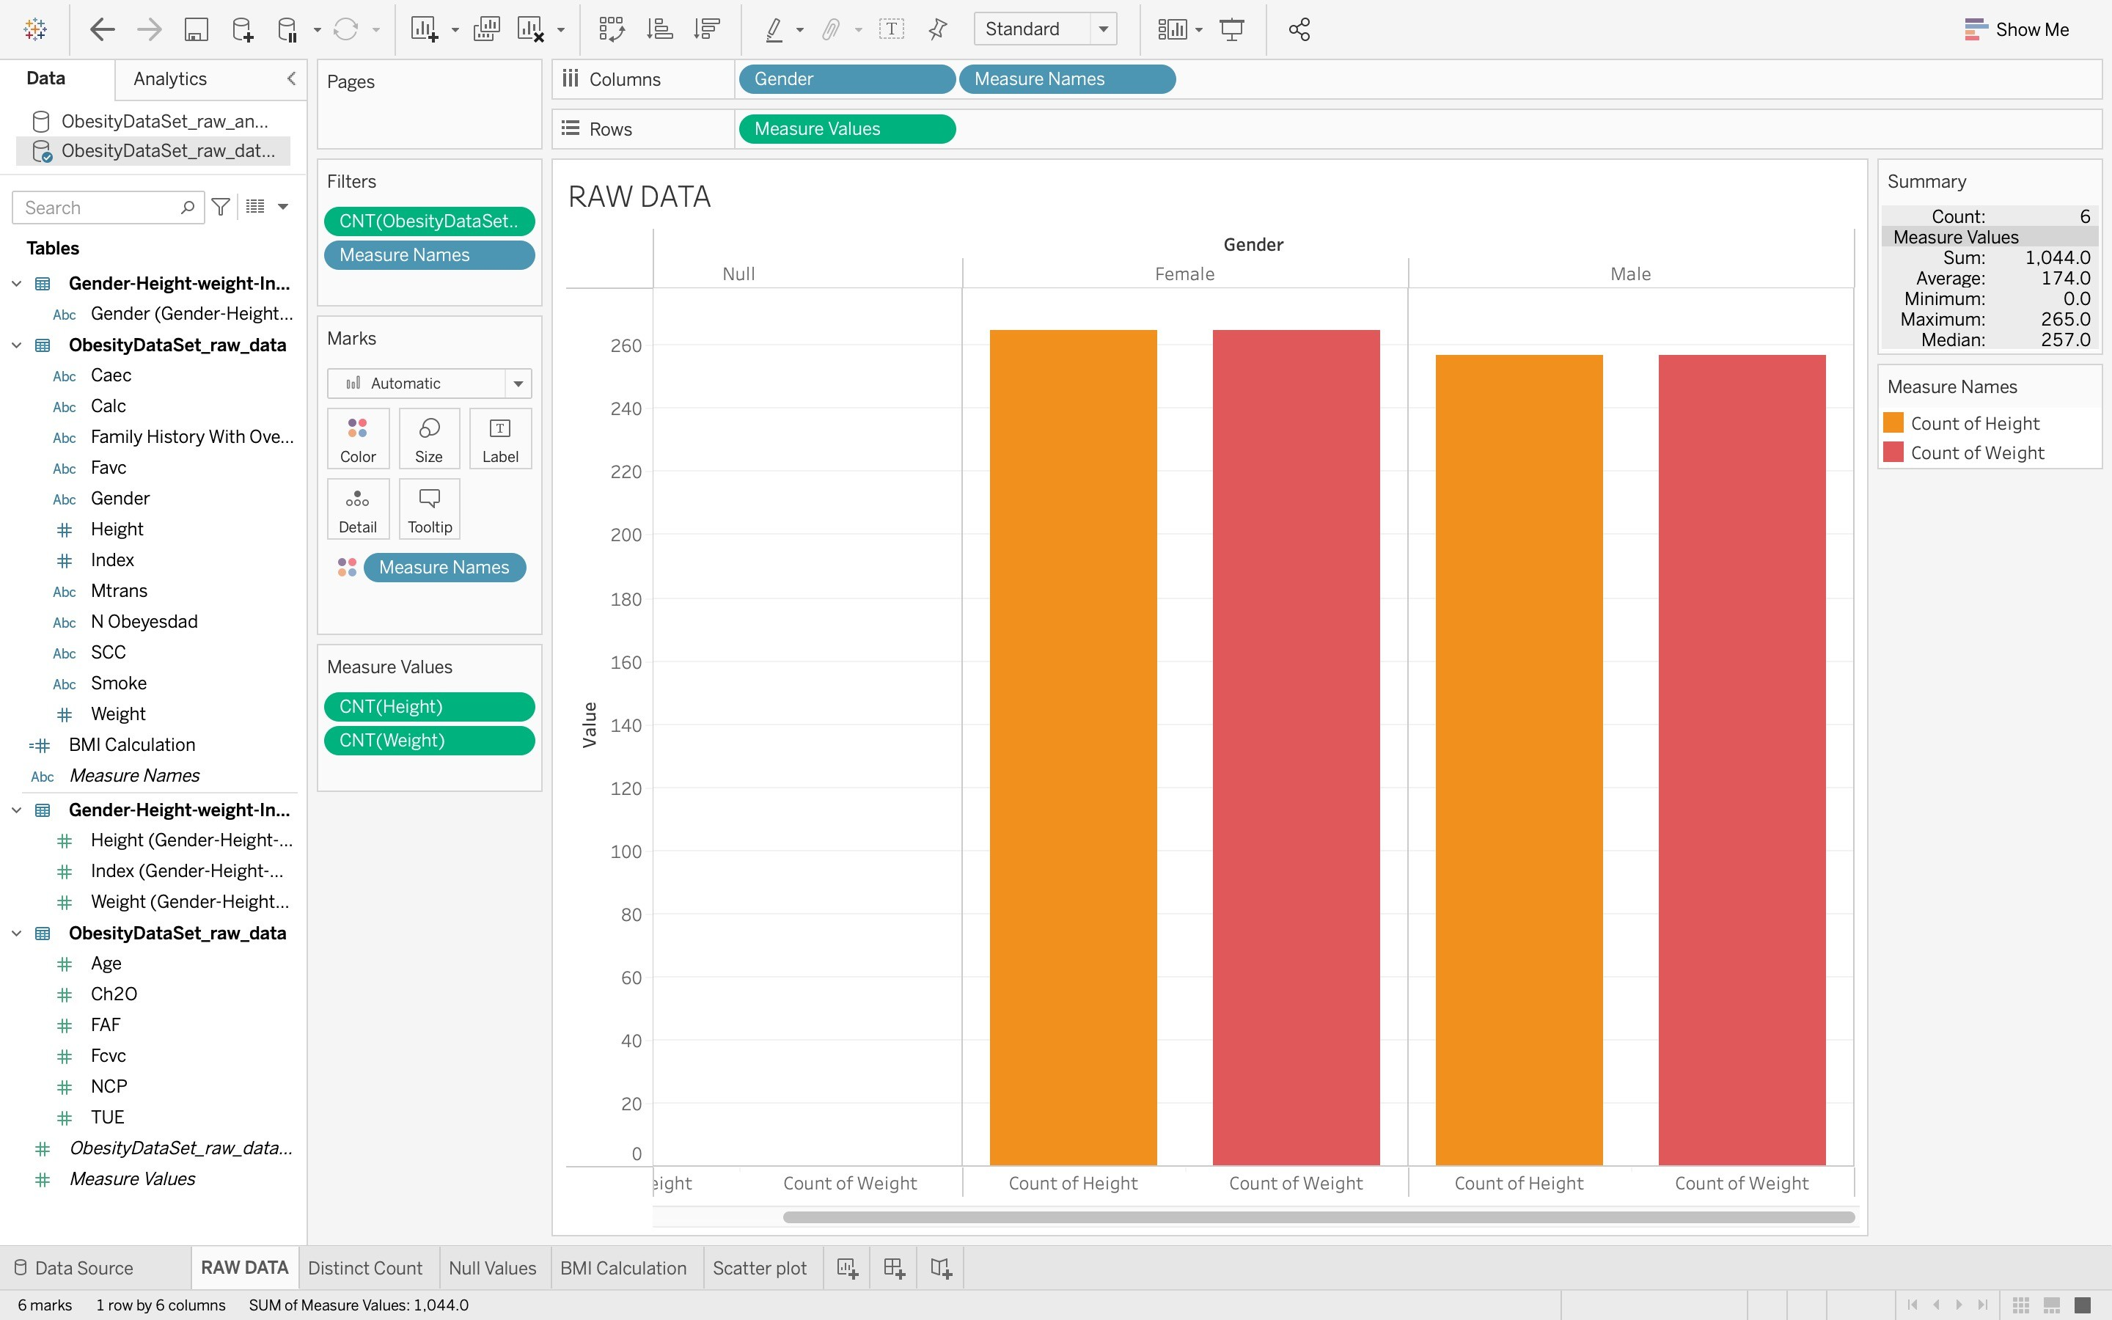

Slide 9
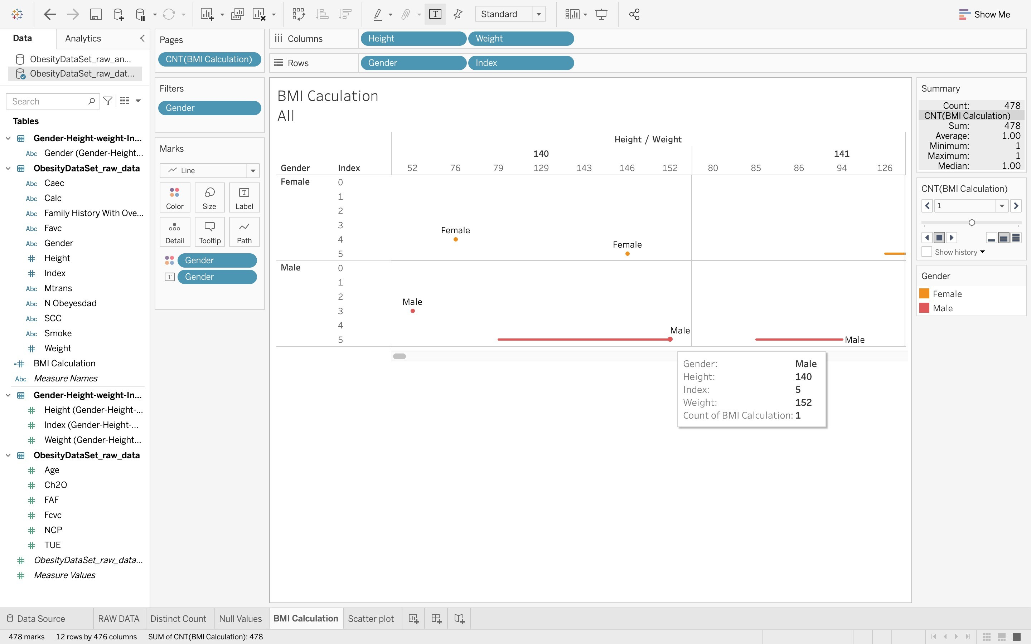
BMI CALCULATION

Slide 10
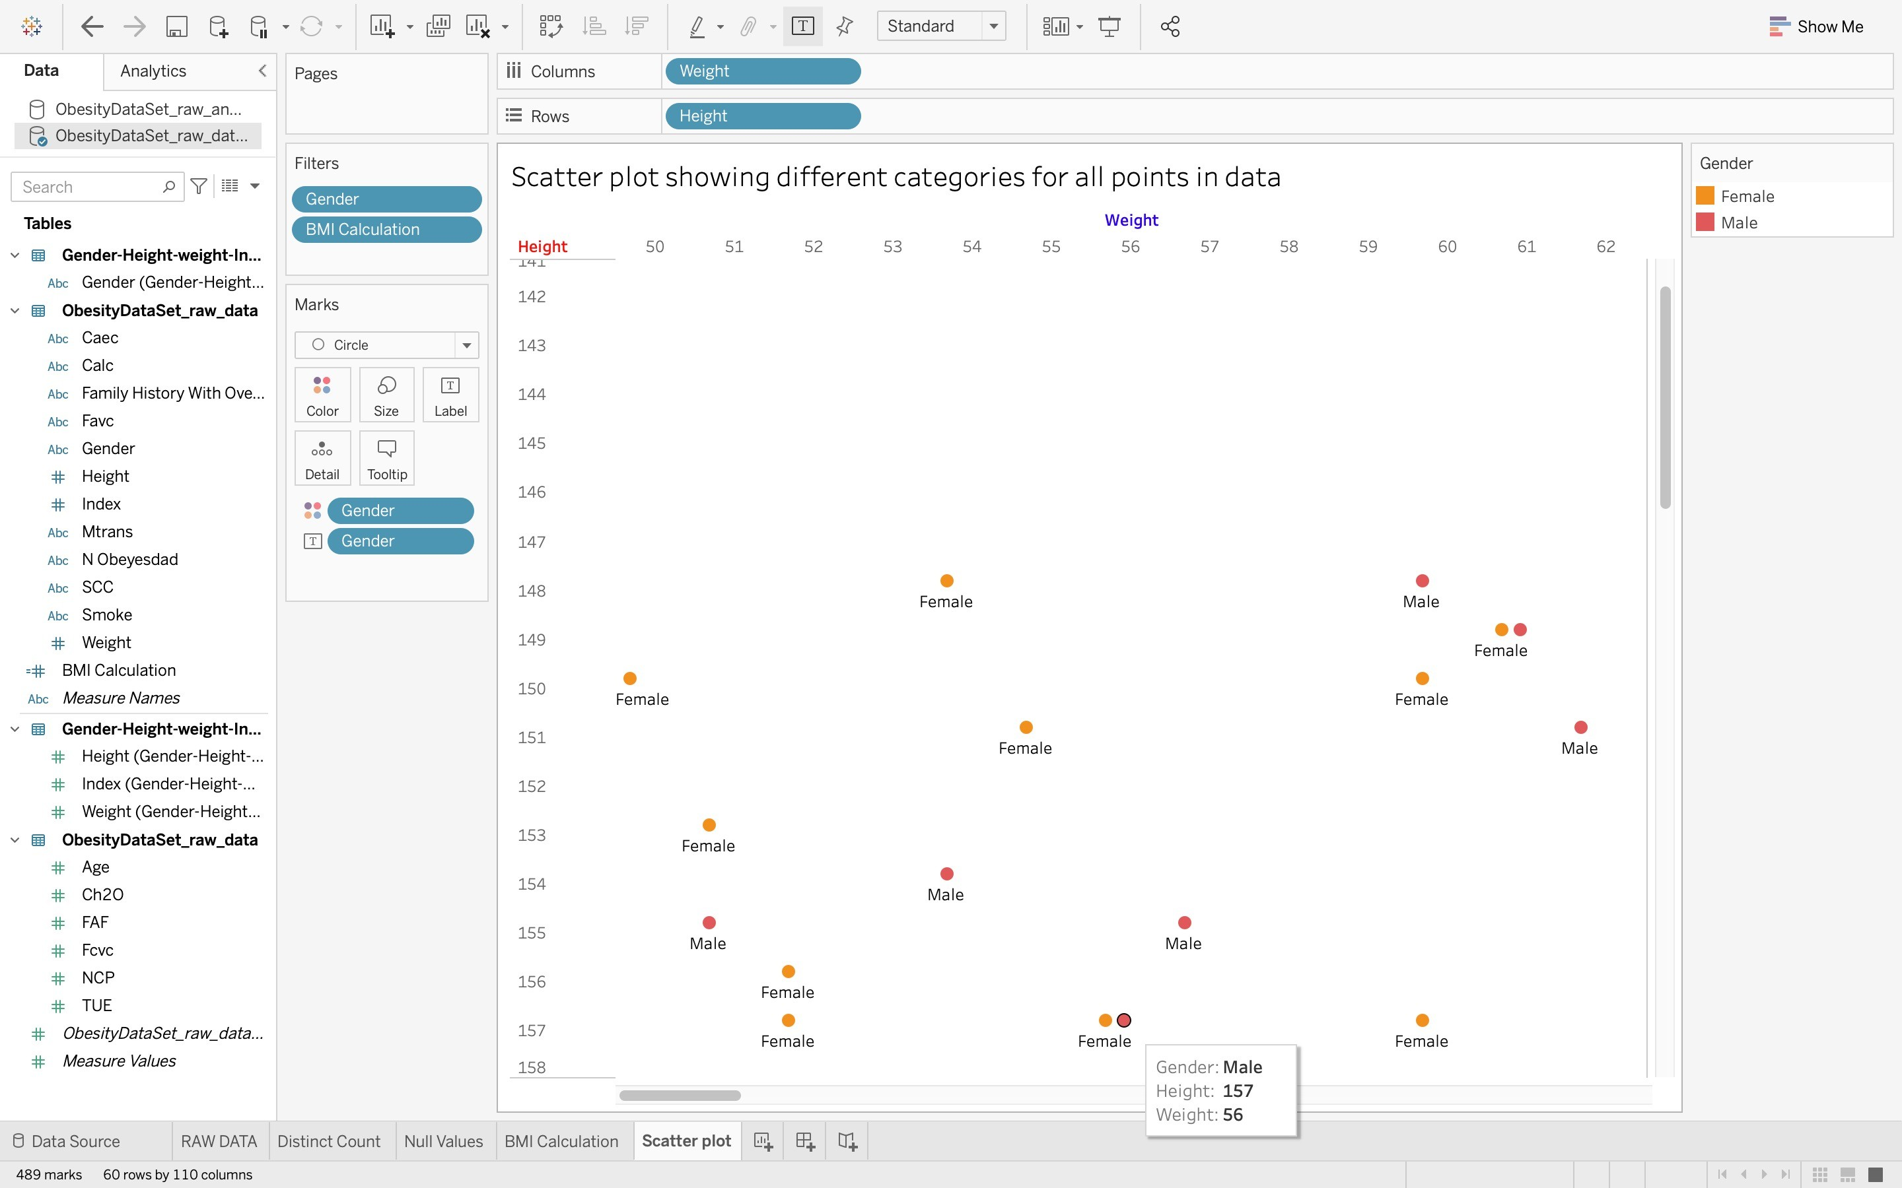
SCATTER PLOT:

Slide 11

Concluding of Hypothesis
Finally, based on the BMI hypothesis, you can predict your health state.
Weight, according to the statistics, is a good determinant of overall health.
To live a healthy life, a human being must check their BMI on a scale of 0-5 and keep track of their weight in relation to their height.
In this research, bigdata analysis assists us in determining the appropriate BMI index scale for any gender.
Exposure of data: I learned more about data preparation, such as merging, cleansing, and male/female classification.
To demonstrate in a visual effect in order to gain a better understanding of the data.
As a result, our hypothesis has been validated in this instance.
10

Slide 12






https://archive.ics.uci.edu/ml/datasets/Estimation+of+obesity+levels+based+on+eating+habits+and+ physical+condition+
https://pubmed.ncbi.nlm.nih.gov/12942320/
https://pubmed.ncbi.nlm.nih.gov/26036702/ https://pubmed.ncbi.nlm.nih.gov/23613066/

